Slide 1


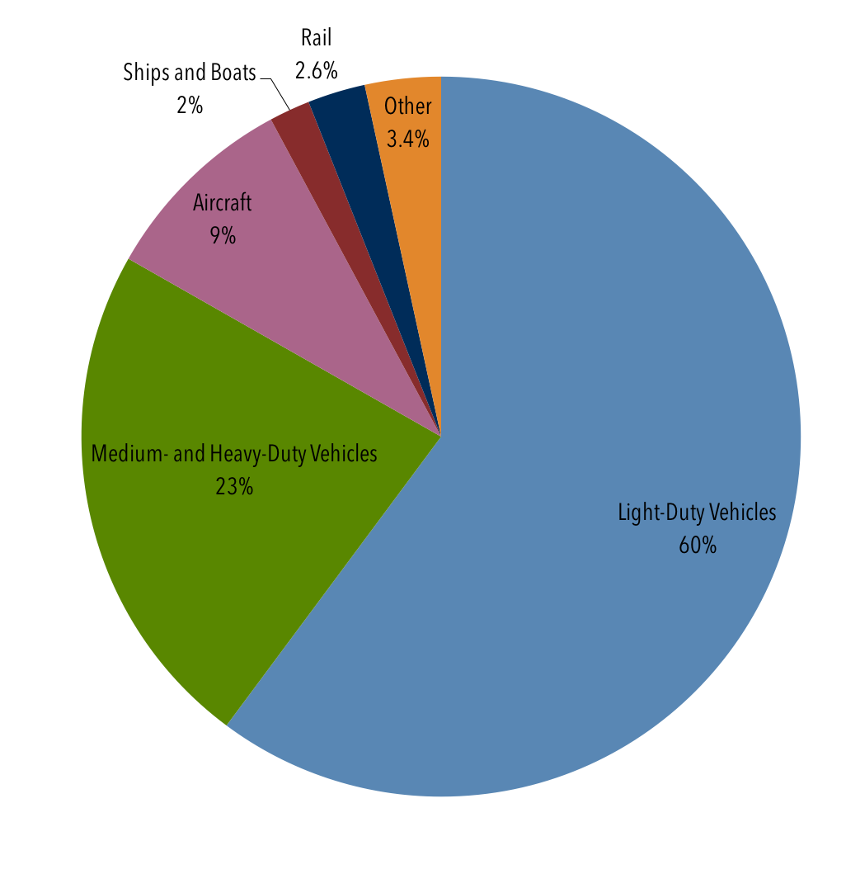
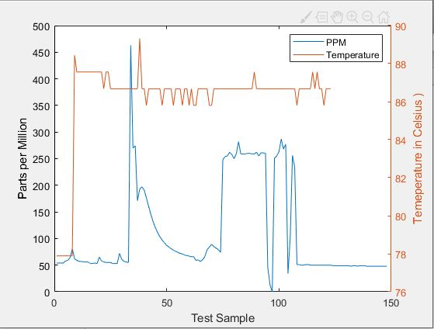
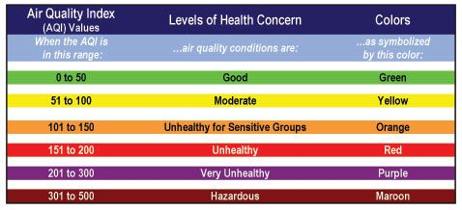
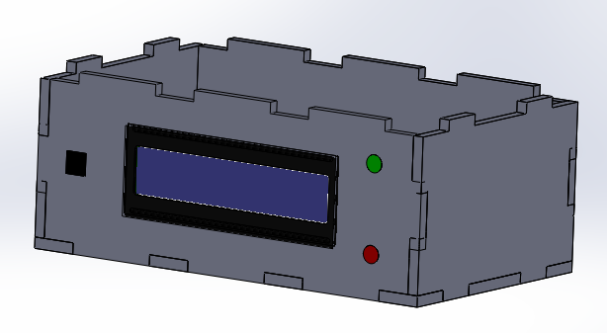
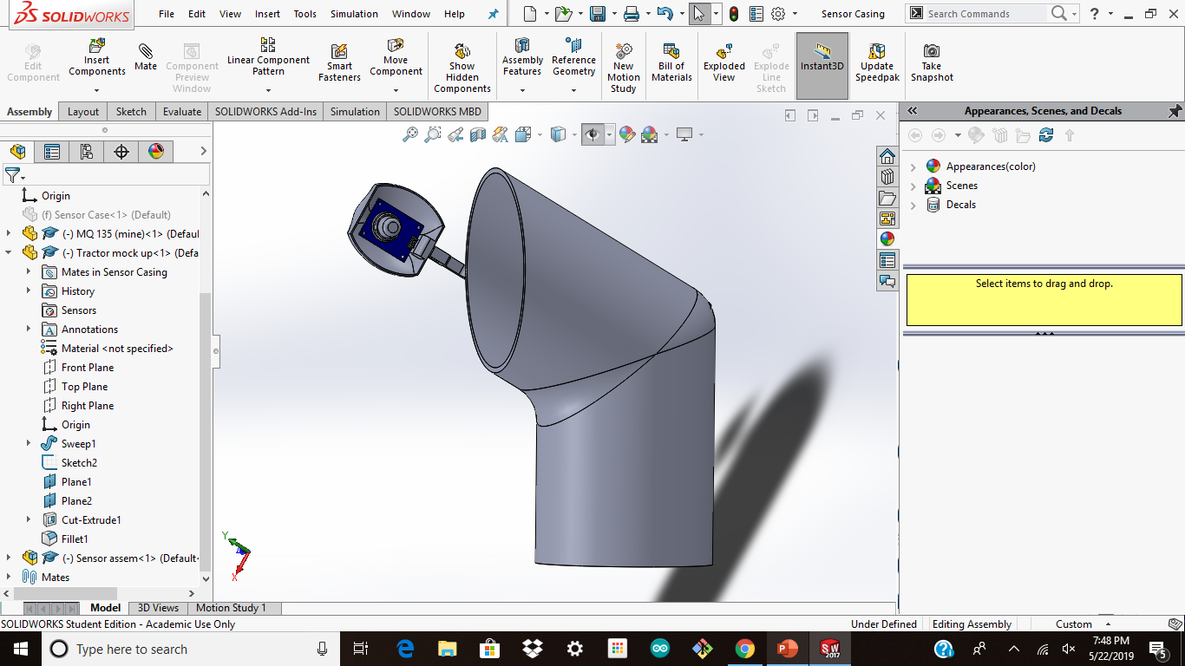
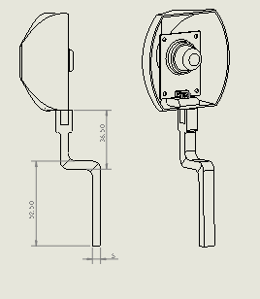
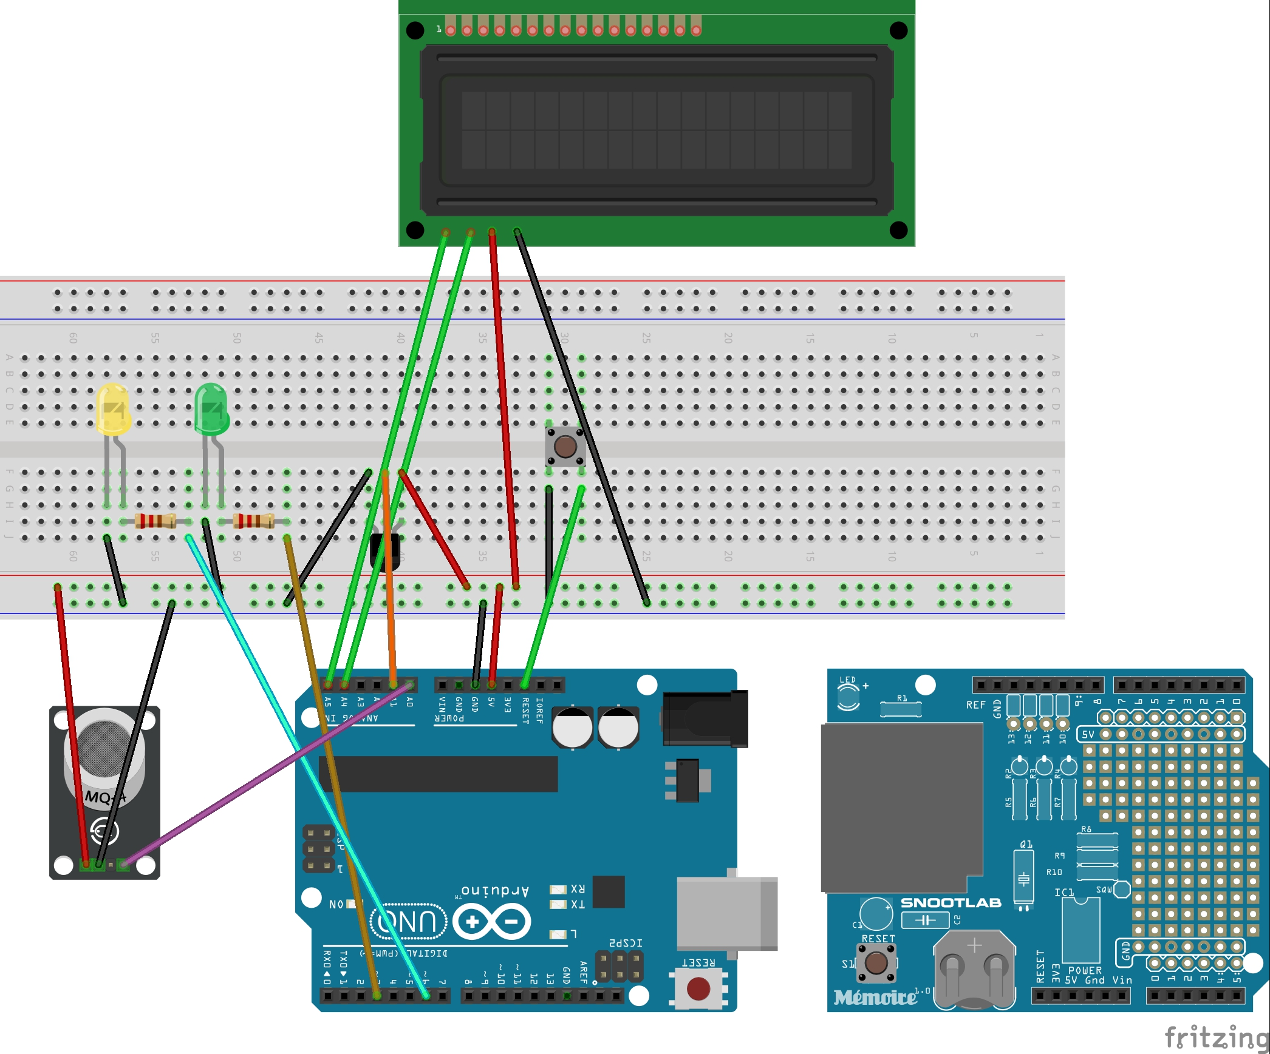
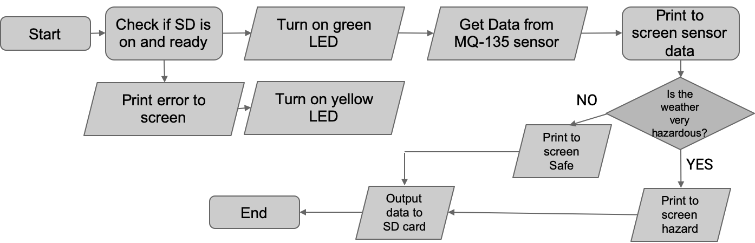
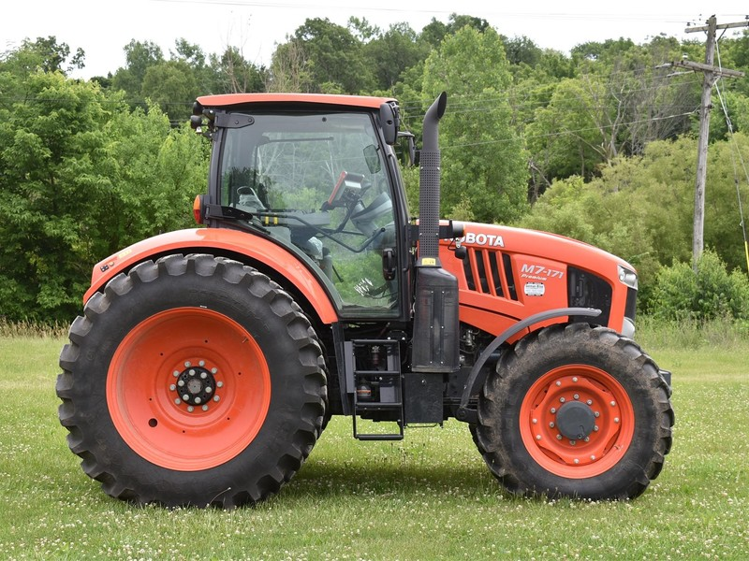
Tracking Tractor Emissions
Alicia Lynch, Ava Fathian-Sabet, Abdallah Hashem, Miguel Salas
Introduction
Measuring the amount of tractor emissions from the Student Farm
Our product will help the Student Farm to be more environmentally friendly by allowing them to track the emissions from their tractors, and make sure that they are performing up to California standards for heavy duty vehicles. Vehicles like tractors burn diesel and emit harmful greenhouse gases such as CO₂, NO_{x}, and NH₃, which all contribute to global warming. The chart to the right shows how much CO₂ each type of vehicle contributes to the atmosphere, showing that heavy duty vehicles are a major problem. The combination of our code and sensor will provide valuable data about the types of emissions that the tractors on the farm are producing, and can potentially be used as evidence that the tractors should be replaced by an electric fleet.
Results
Designs
In order to protect the sensor from the elements, it will have a small overhang casing as shown in the figure below. The casing has a cut out where the sensor will click into place and be automatically wired with the rest of the circuit.
Methods
Using MQ-135 sensor to track PPM emissions from tractor exhaust pipe.
The sensor we have chosen can detect CO₂, NO_{x}, and smoke, all of which are emitted by tractors, and are important to keep track of. It is small and inexpensive which makes it easy to use and replace, and it can be powered using the same battery as the Arduino. The sensor will be held in a protective case next to the tractor exhaust pipe, while the rest of the circuit with the Arduino and SD card will be held inside the tractor cab, as they are more delicate. The SD card will save all of the sensor data as it is generated. Then a separate MATLAB program will automatically generate graphs from the data, with no user input required. Then the data can easily be compared against California standards.
Inside the cab of the vehicle, the rest of the circuit will be contained inside a box as shown in the figure above. This box will include the Arduino, the SD card, and an LCD screen that reads the status of the sensor. The top of the box will hinge for easy access to the SD card.
Analysis
The graph shows that exhaust temperature increases very quickly at the beginning of the test, but levels off at an acceptable temperature for the vehicle. Throughout the course of the test the PPM readings vary quite a bit due to the type of activity that the vehicle is doing, with idling corresponding to lower PPM. Aside from a spike at the beginning, the PPM remains at a very unhealthy AQI for the duration of the test.
The circuit includes an SD card reader, the MQ- 135 sensor, a reset button, a temperature sensor, an LCD screen and two LEDs. The LCD screen prints relevant temperature and AQI assessments. The LEDs indicate whether the SD card is reading values.
Flowcharts
Arduino
Future Work
YES
Making our device more widespread and durable.
In the future, we would like to make this device applicable to vehicles other than tractors so that anyone could track the emissions of their own car or truck easily and quickly. If the sort of pollutants being emitted by heavy duty vehicles were to be taxed in the future, our device would be a straightforward way to keep track of emissions from a vehicle for tax purposes. In order to reach those goals, we would need to find a more durable material for the sensor case so that it could withstand greater temperature ranges and better protect the sensor itself. Additionally, we would like to add more advanced sensors that can more specifically detect certain emissions, as our current sensor only measures PPM and does not identify the individual gases being emitted.
Print toscreen “Hazar”
Matlab
Start
Import data from SD card
Plot imported values
Add report titles and data
End
Export a report based on input values
Generate tables from predefined calculations
Acknowledgements
We would like to acknowledge Dr. Mullin, ENG 3 teaching assistants, Jim Muck, the Dorf Family, and the ESDC for their support.
References
“Ammonia,” Pollutant Fact Sheet. [Online]. Available: http://apps.sepa.org.uk/spripa/Pages/SubstanceInformation.aspx?pid=1. [Accessed: 22-May-2019].
C. Arapatsakos and T. Gemtos, “Tractor Engines and Gas Emissions,” WSEAS TRANSACTIONS on ENVIRONMENT and Development, Oct. 2008.
Notes:
Things to do still:
*headers - 36 font
* text - 24-30 font
Background: https://expandingthepresence.com/wp-content/uploads/astronomy-atmosphere-aurora-borealis.jpg
from : https://expandingthepresence.com/astronomy-atmosphere-aurora-borealis/

